Slide 1
ParkEz Application

Slide 2
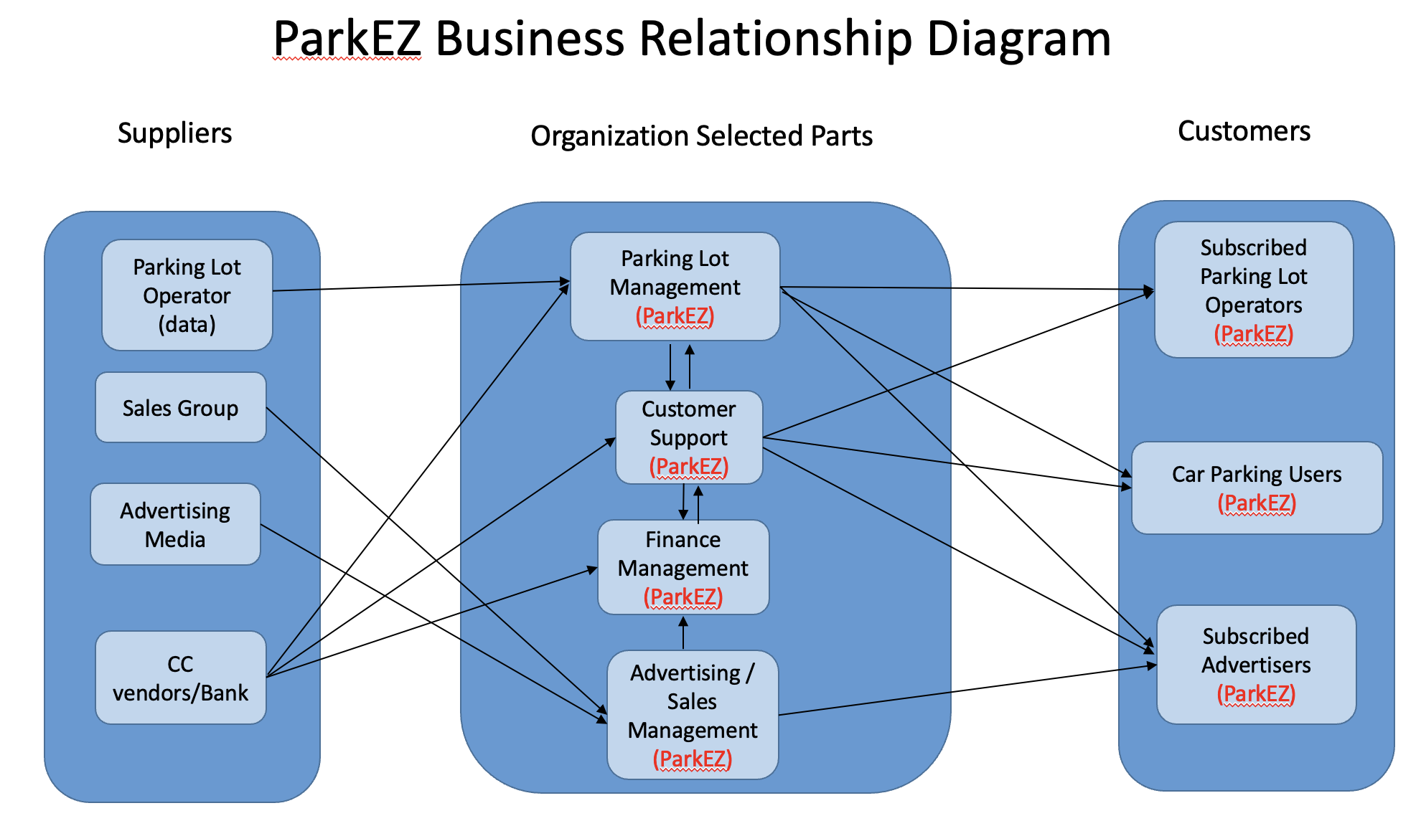
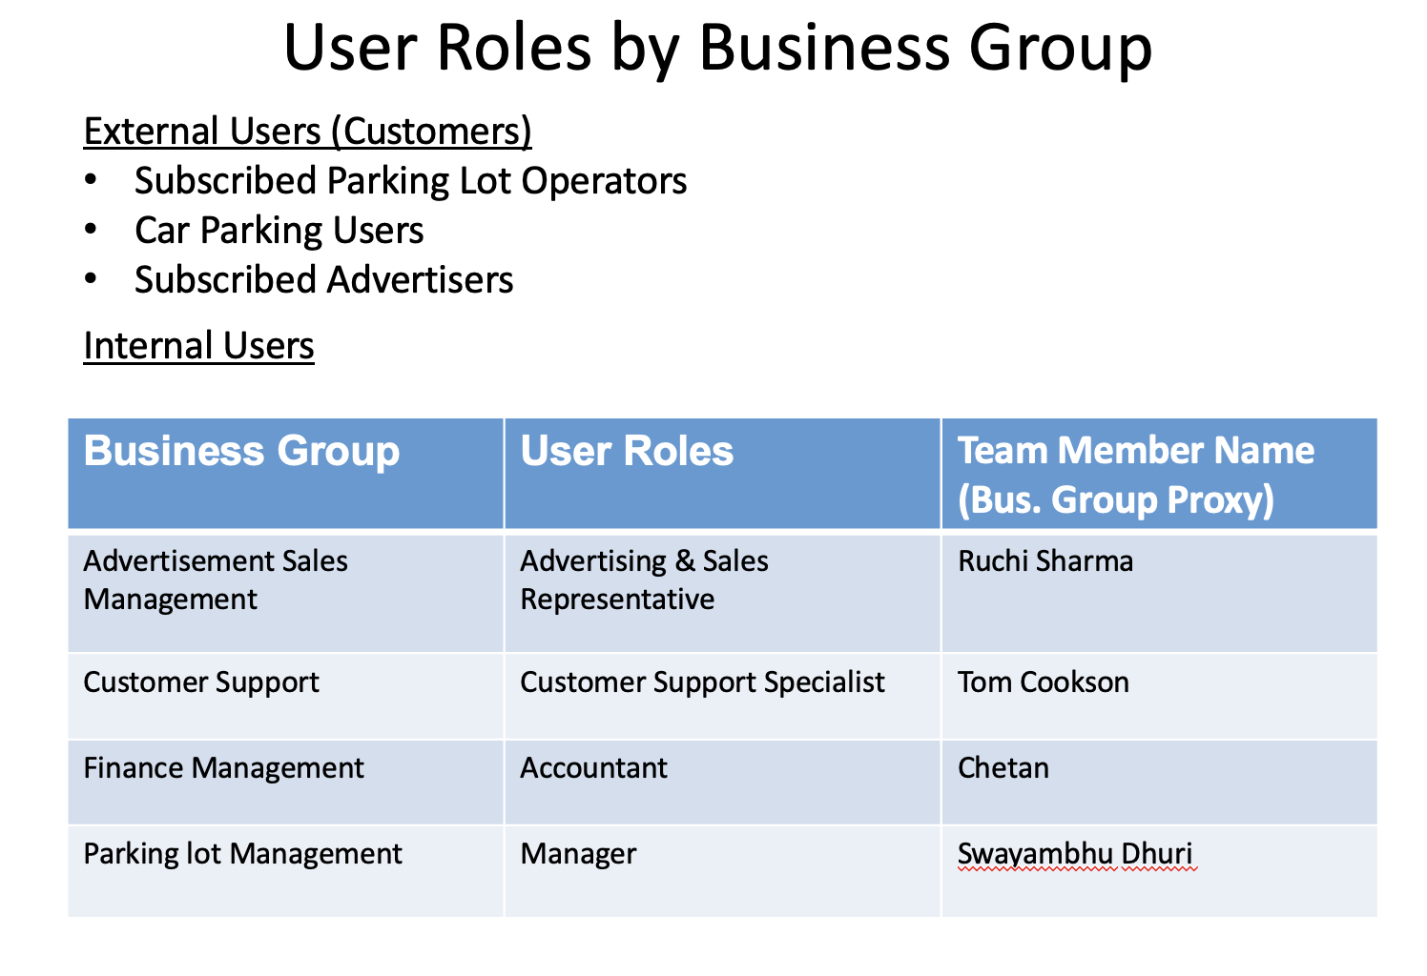
1. BRM Diagram User Roles – Shubham Mittal
https://github.com/swayambhu/parkEz/blob/main/Documents/final_persentation/3.%20BRMDiagram_UserRoles.pptx

Slide 3
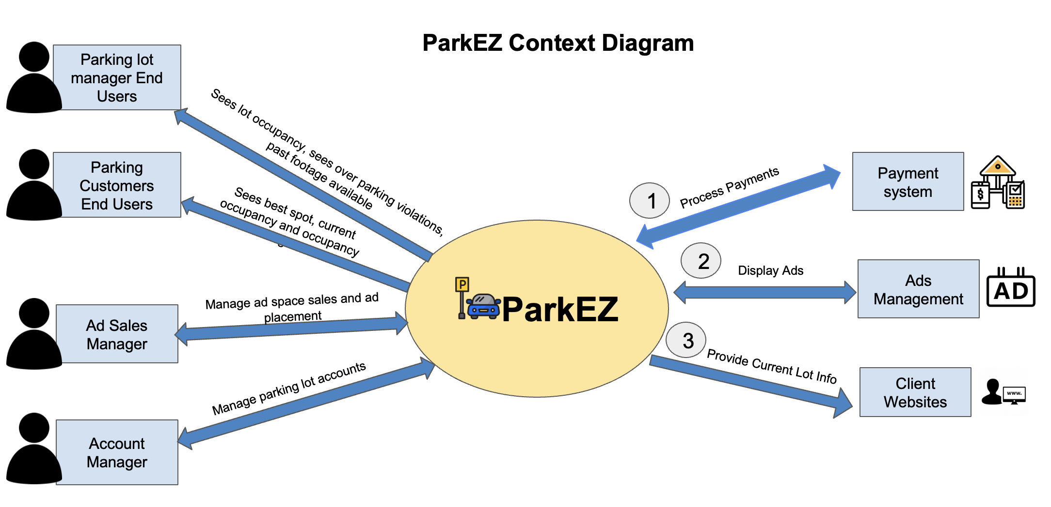
2. Context Diagram – Srija Reddy
https://github.com/swayambhu/parkEz/blob/main/Documents/final_persentation/4.%20ContextDiagram-SystemlnterfaceTable.pptx

Slide 4
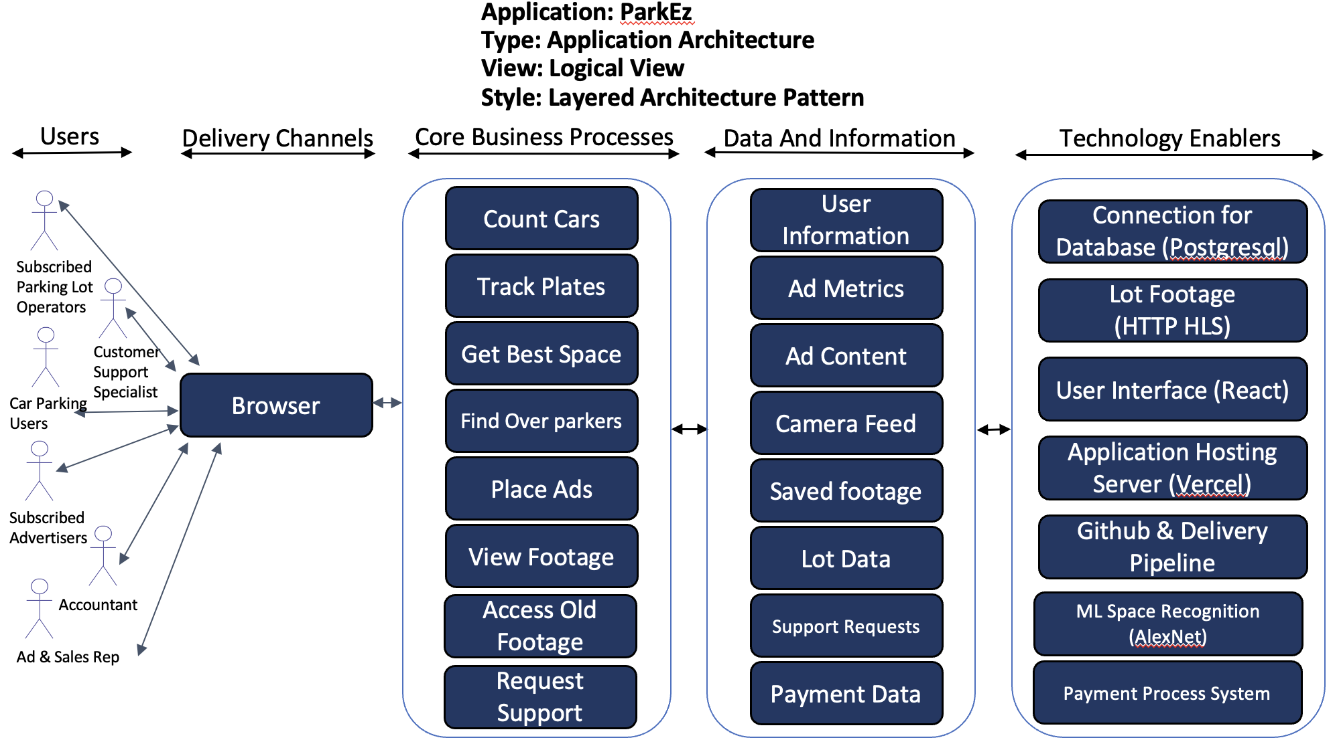
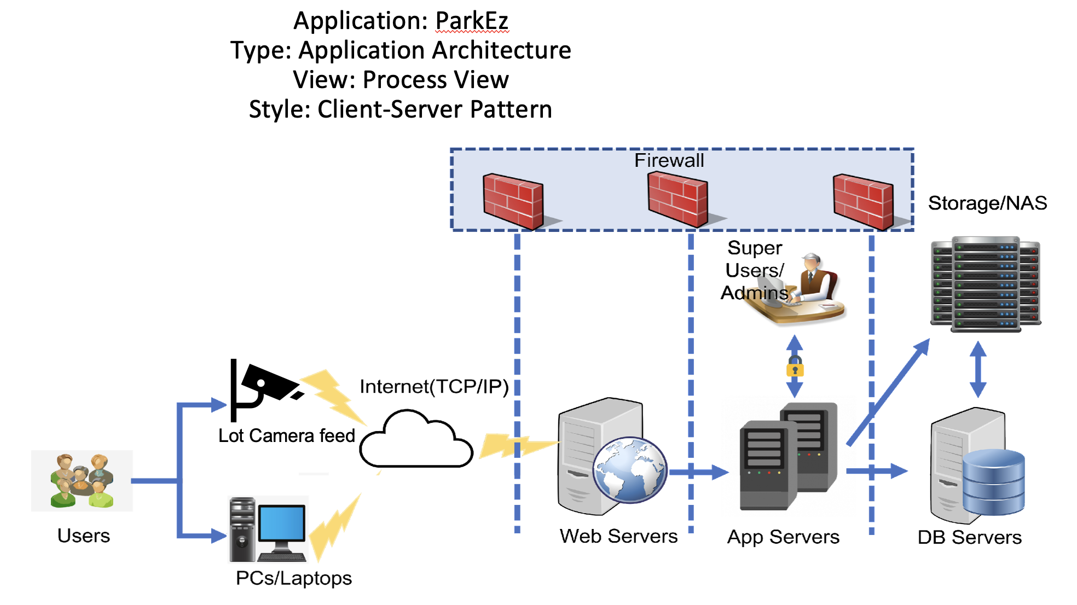
3. Architecture Diagram – Shubham Mittal
https://github.com/swayambhu/parkEz/blob/main/Documents/final_persentation/1.%20ProjectPlan.xlsx

Slide 5
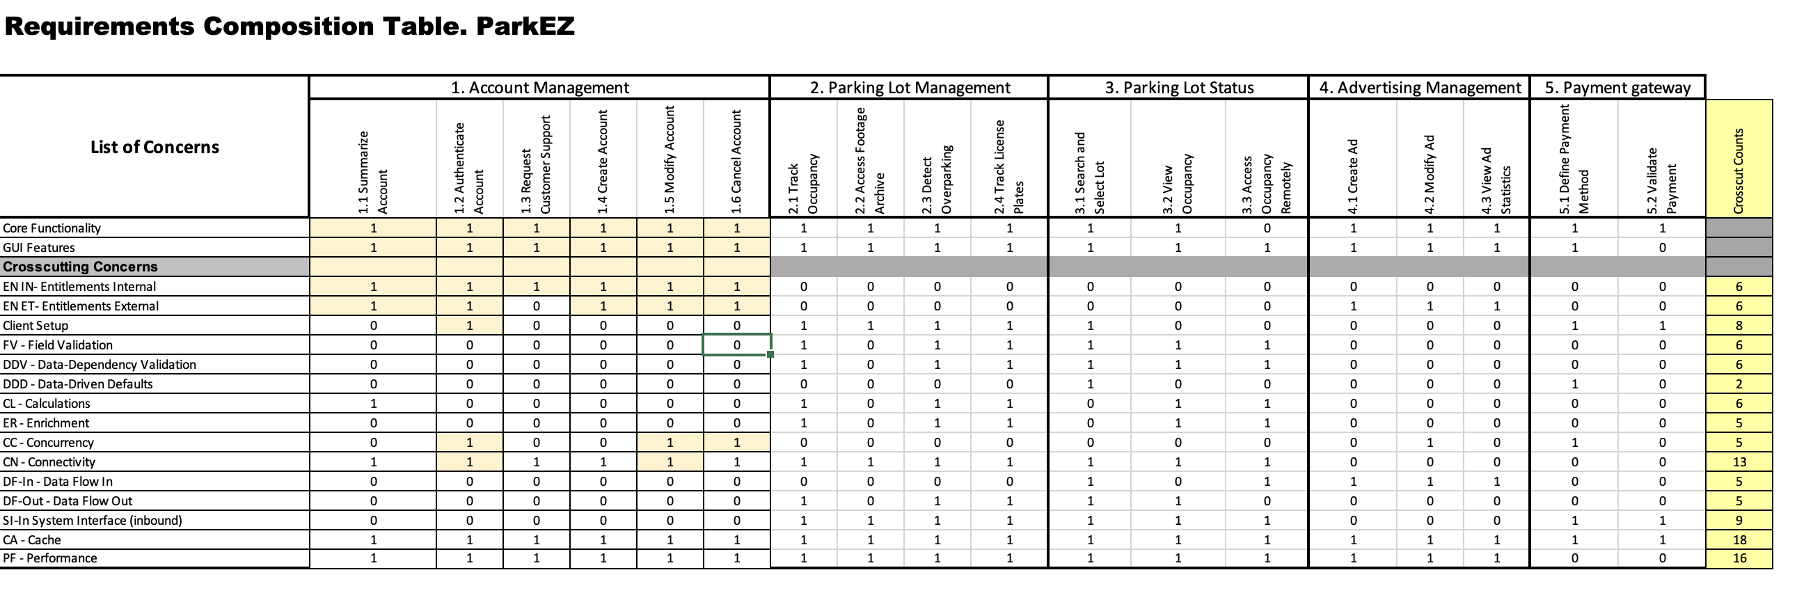
4. RCT – Ruchi Sharma
https://github.com/swayambhu/parkEz/blob/main/Documents/final_persentation/7.%20RCT.xlsx

Slide 6
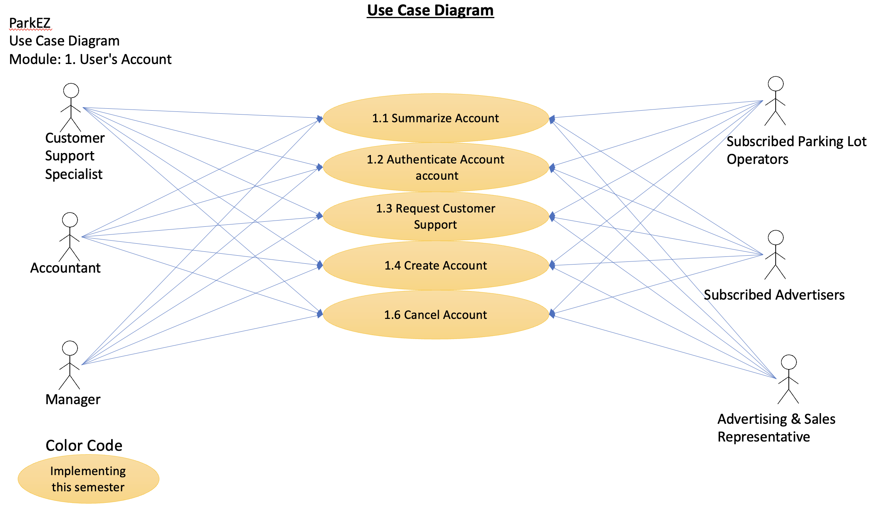
5. Use Case Diagram – Chetan Besnat
https://github.com/swayambhu/parkEz/blob/main/Documents/final_persentation/8.%20UseCaseDiagrams-(UML).pptx

Slide 7
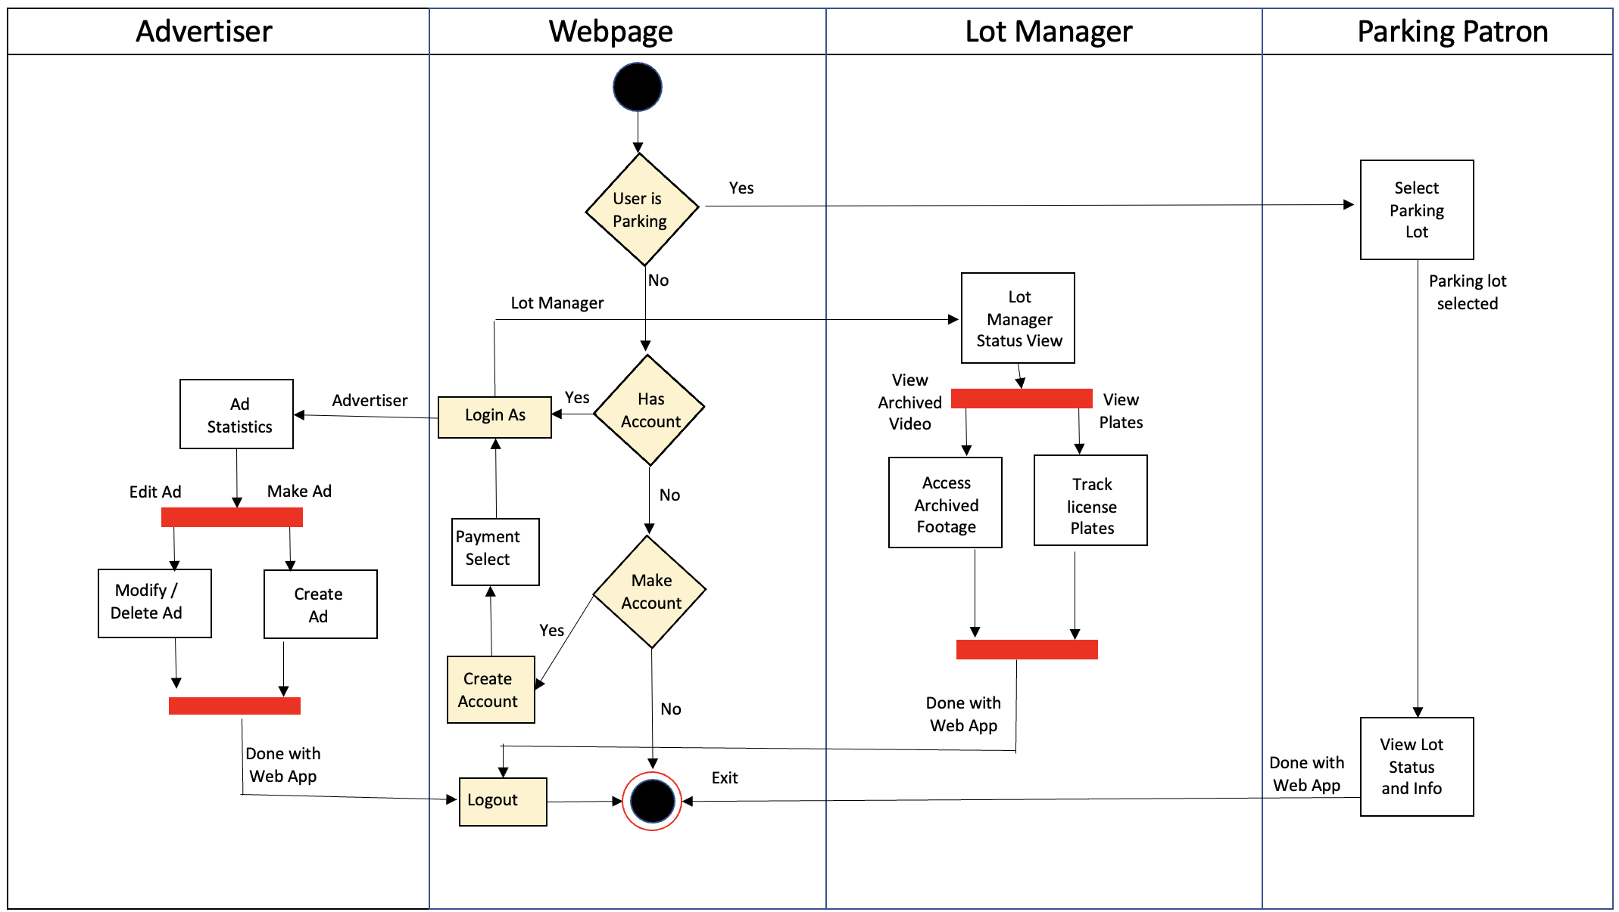
6. Activity Diagram-(UML) – Srija Reddy
https://github.com/swayambhu/parkEz/blob/main/Documents/final_persentation/9.%20ActivityDiagram-(UML).pptx

Slide 8
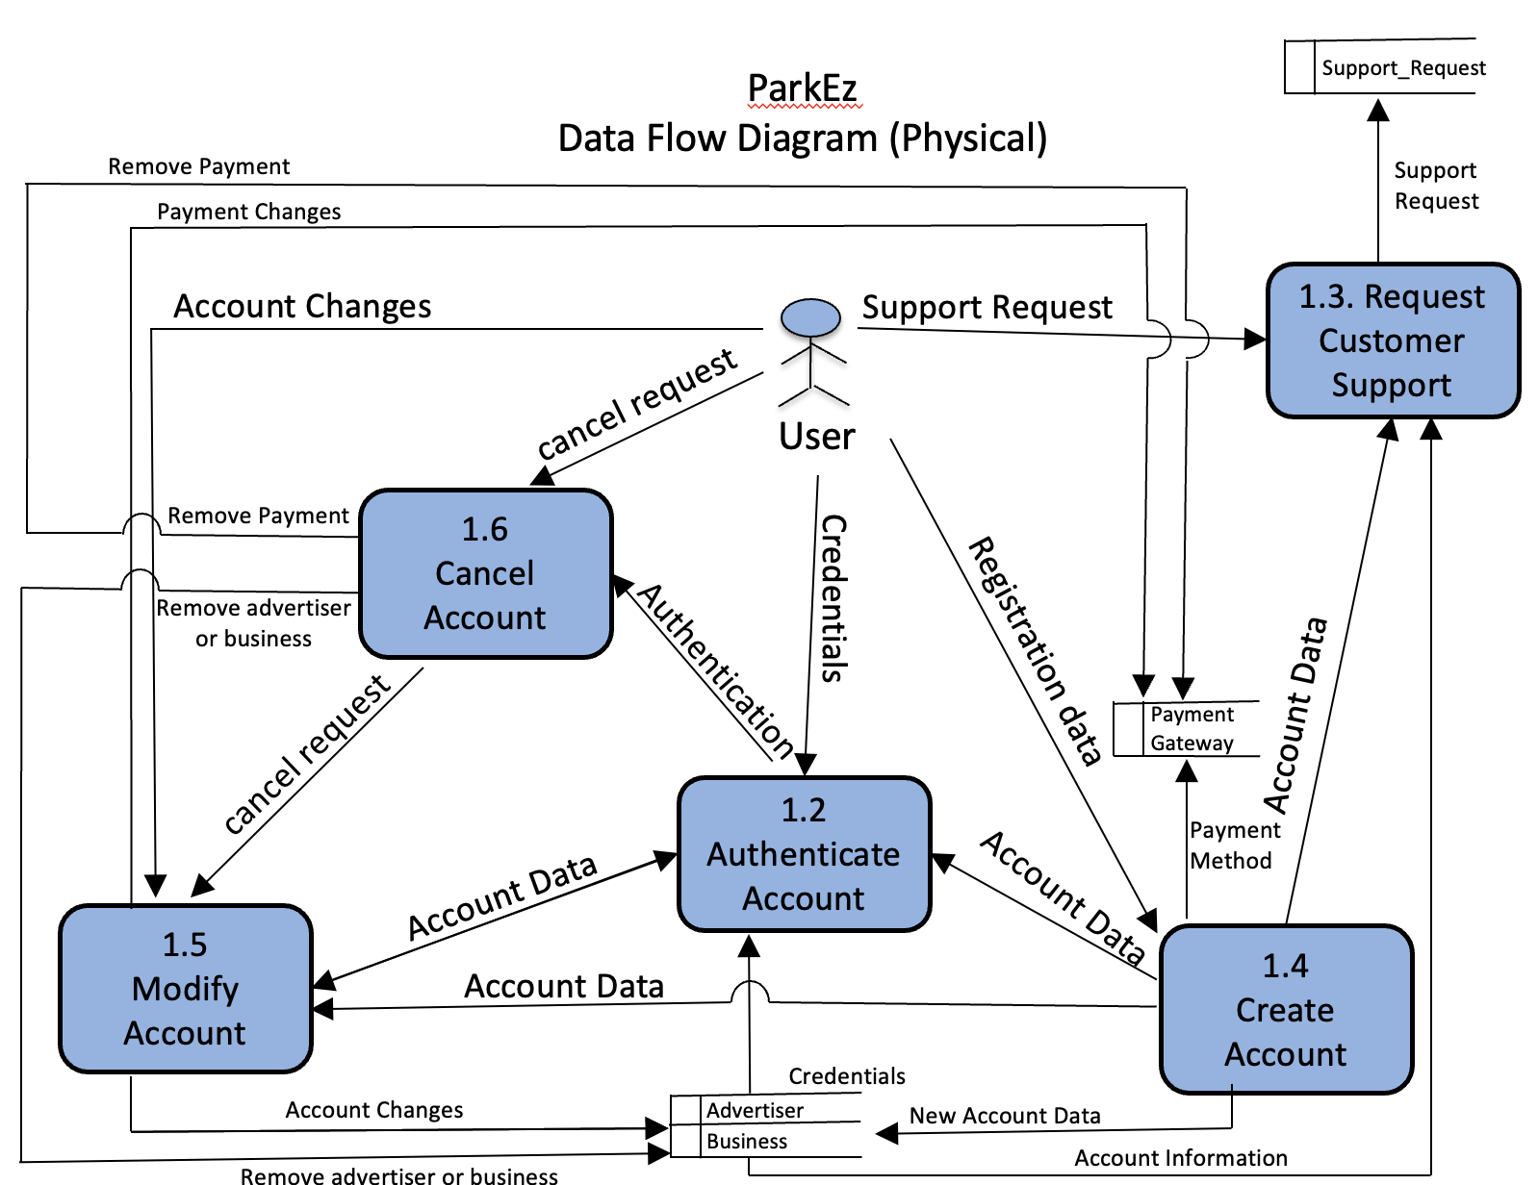
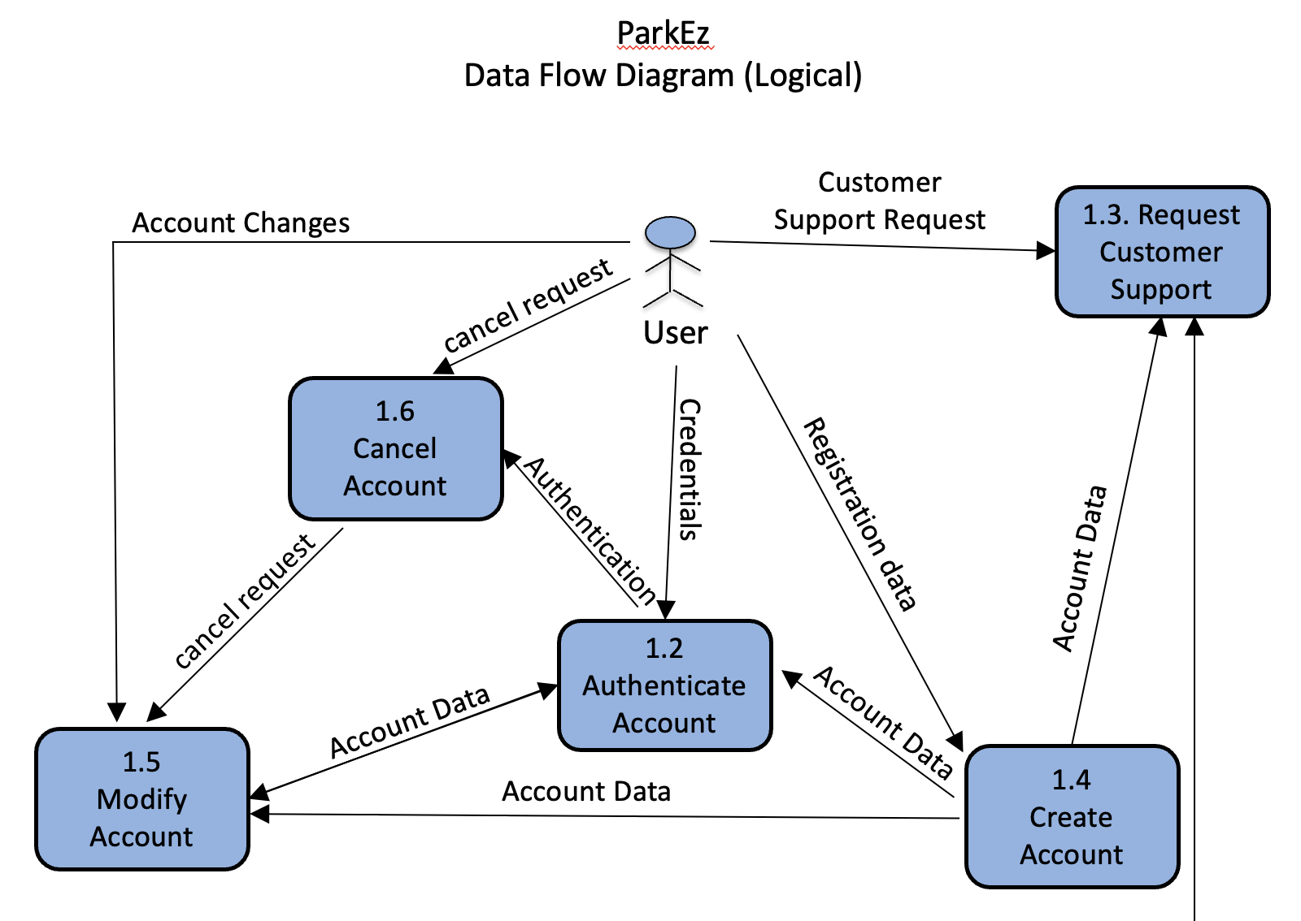
7. Data Flow Diagram - Krunal
https://github.com/swayambhu/parkEz/blob/main/Documents/final_persentation/10.%20DataFlowDiagrams-(Logical%2CPhysical)%20.pptx

Slide 9
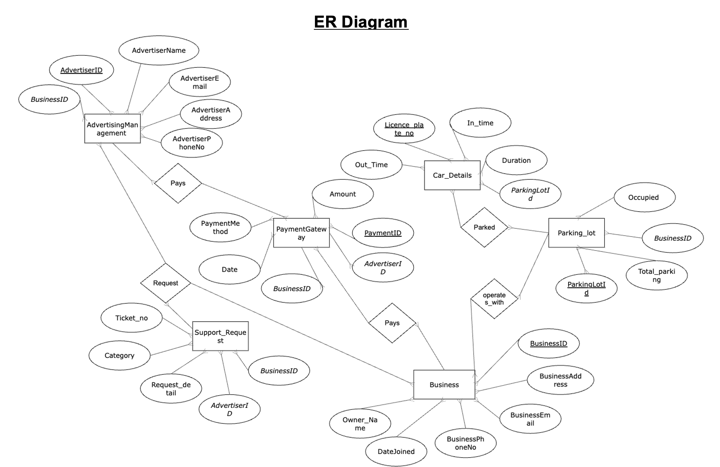
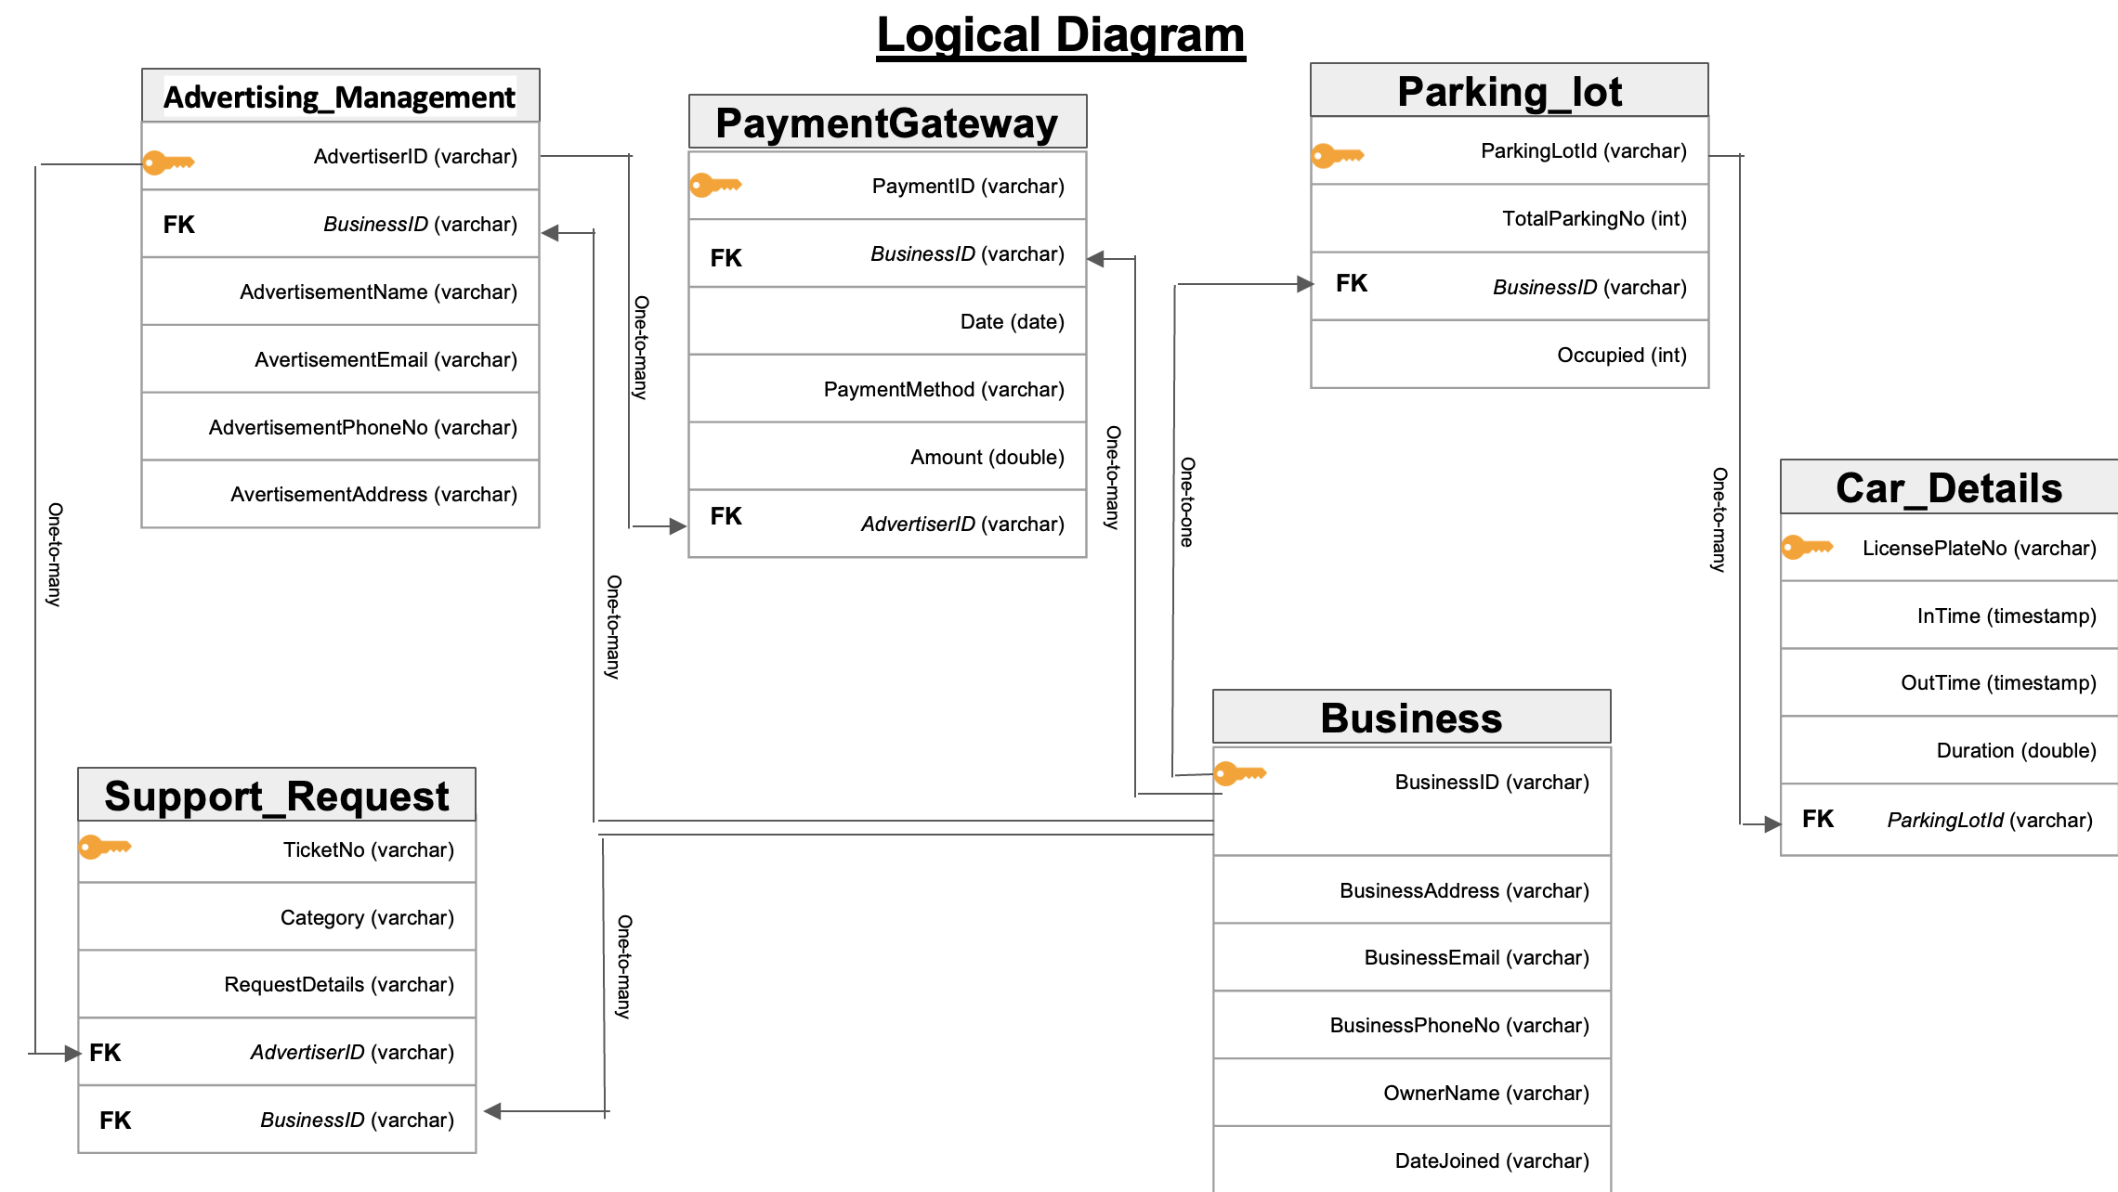
8. ER – Diagram – Suruchi Patil
https://github.com/swayambhu/parkEz/blob/main/Documents/final_persentation/14.%20ER-Diagrams-(Conceptual.Logical).pptx

Slide 10
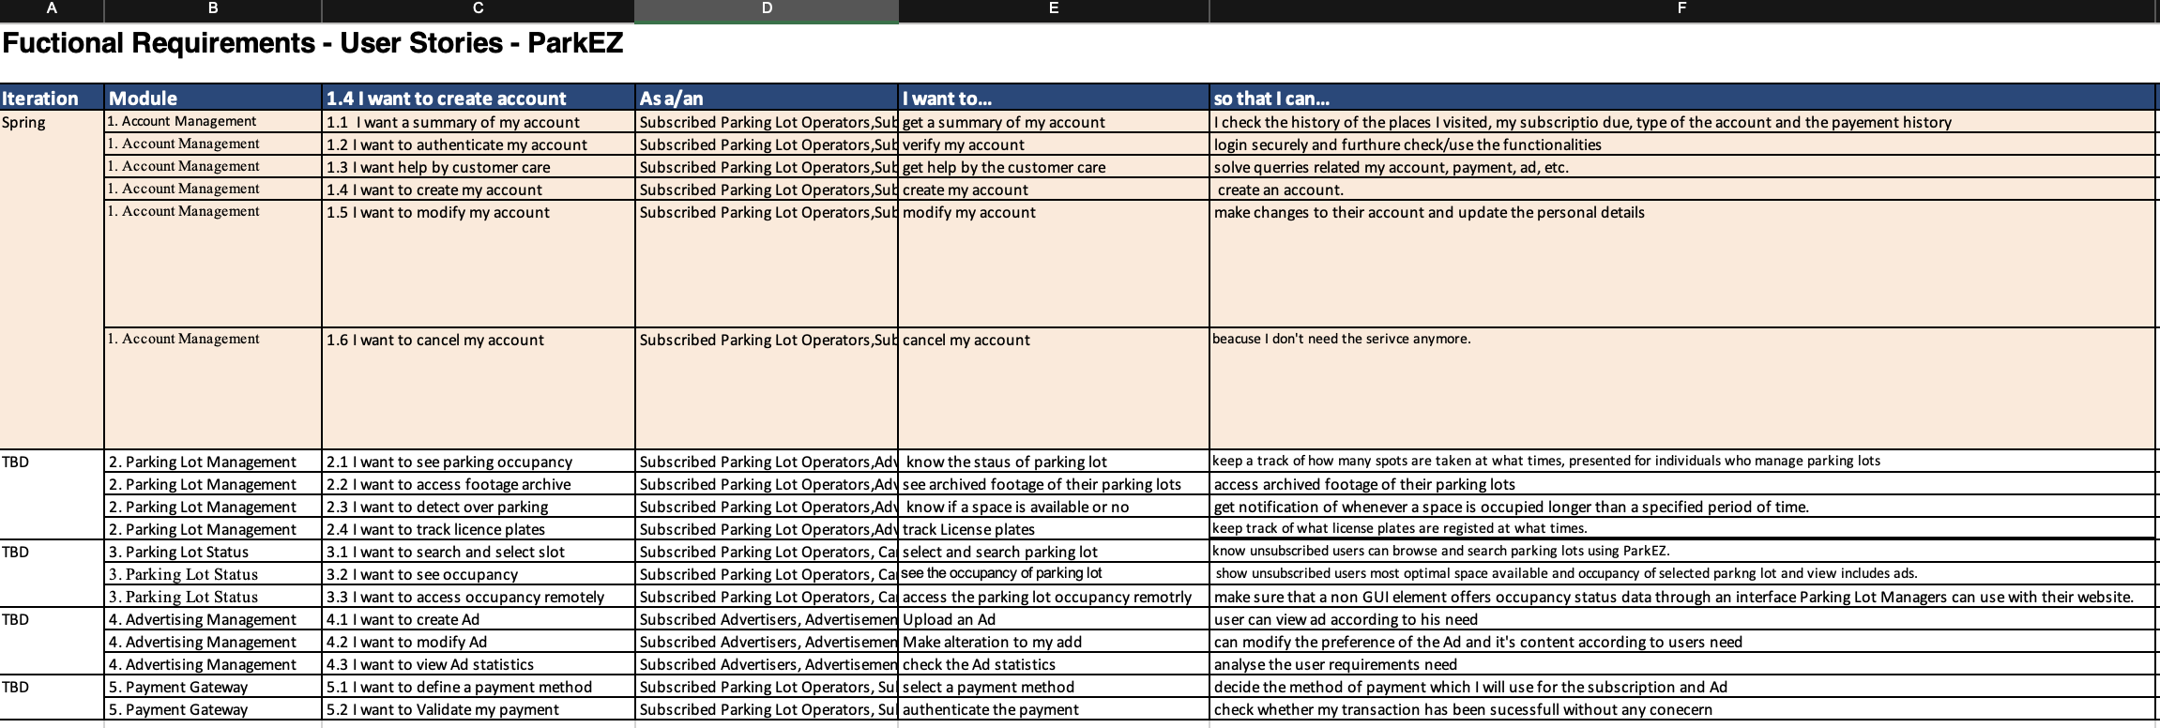
9. Functional Requirements – Tom Cookson
https://github.com/swayambhu/parkEz/blob/main/Documents/final_persentation/11.%20FunctionalRequirements-(UserStories).xlsx

Slide 11
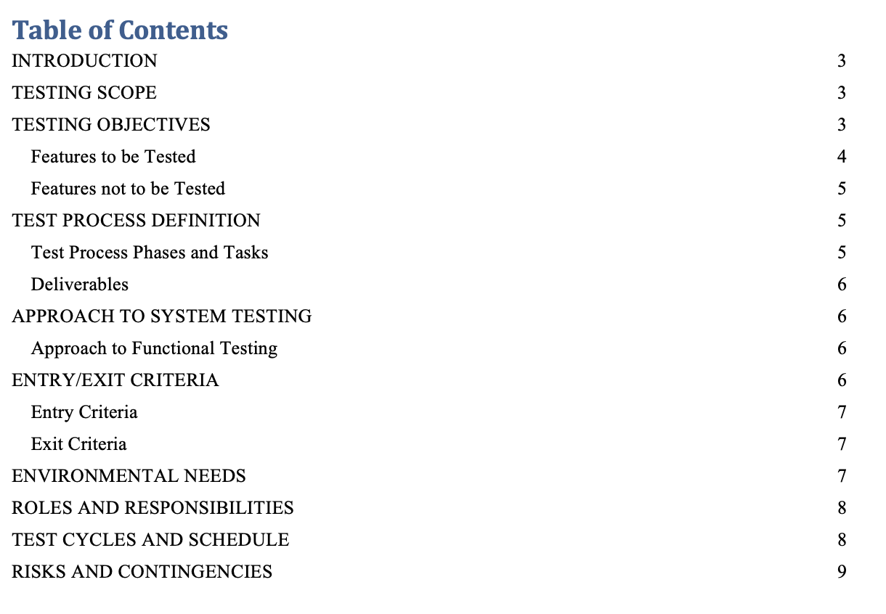
10. Test Plan – Tom Cookson
https://github.com/swayambhu/parkEz/blob/main/Documents/final_persentation/17.%20TestPlan-Document.docx

Slide 12
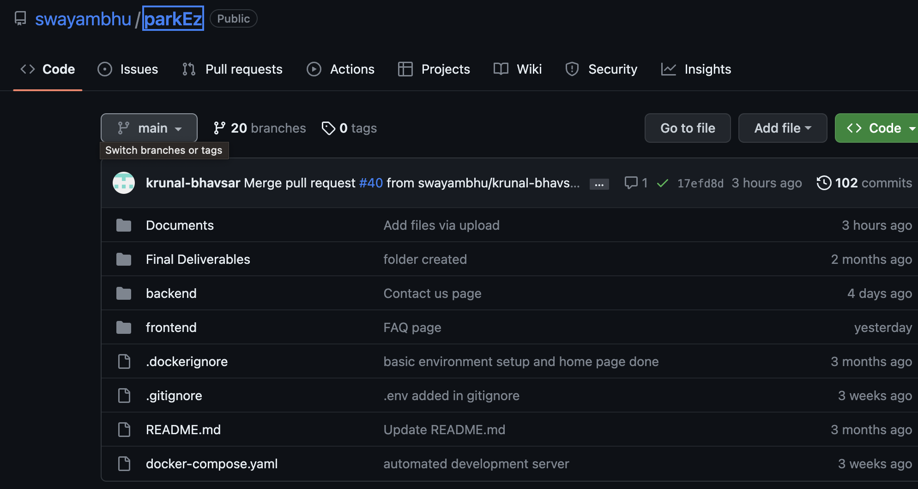
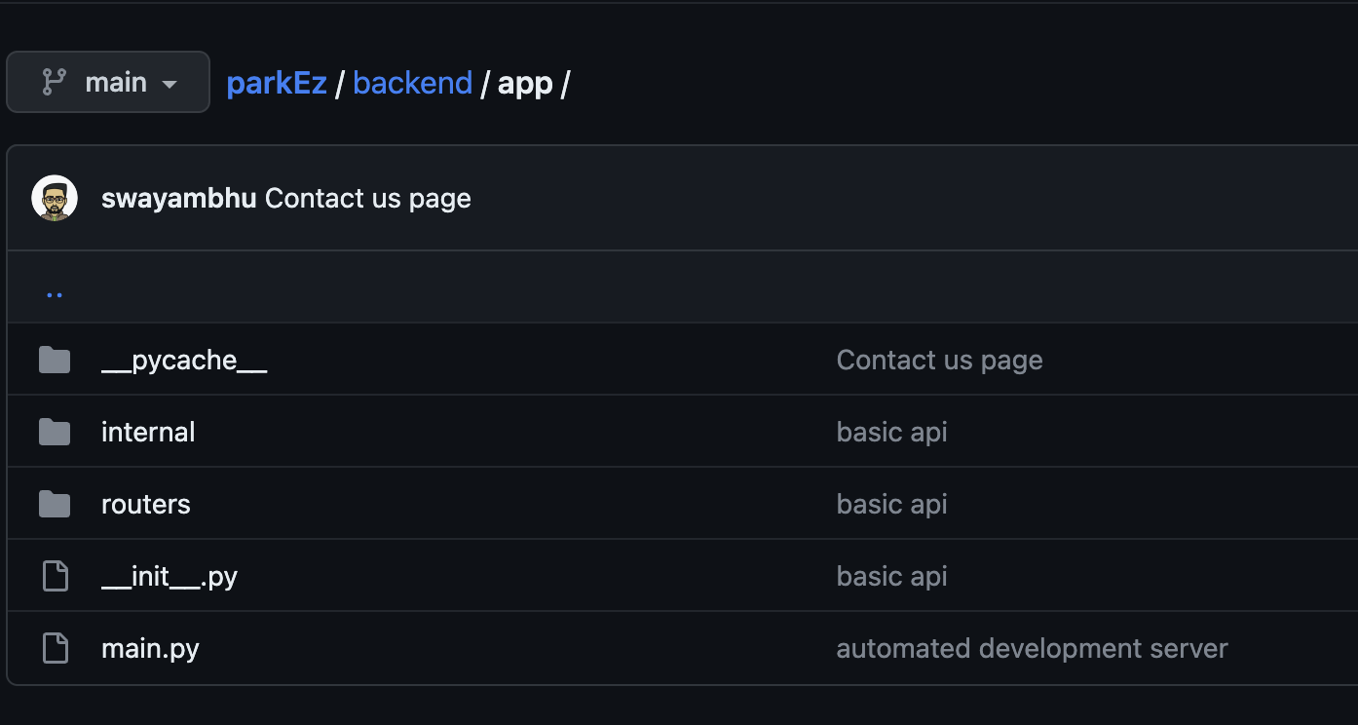
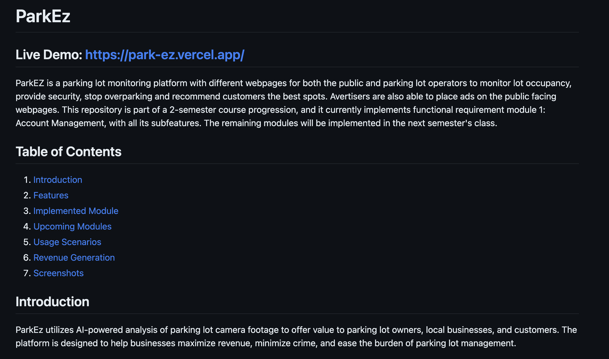
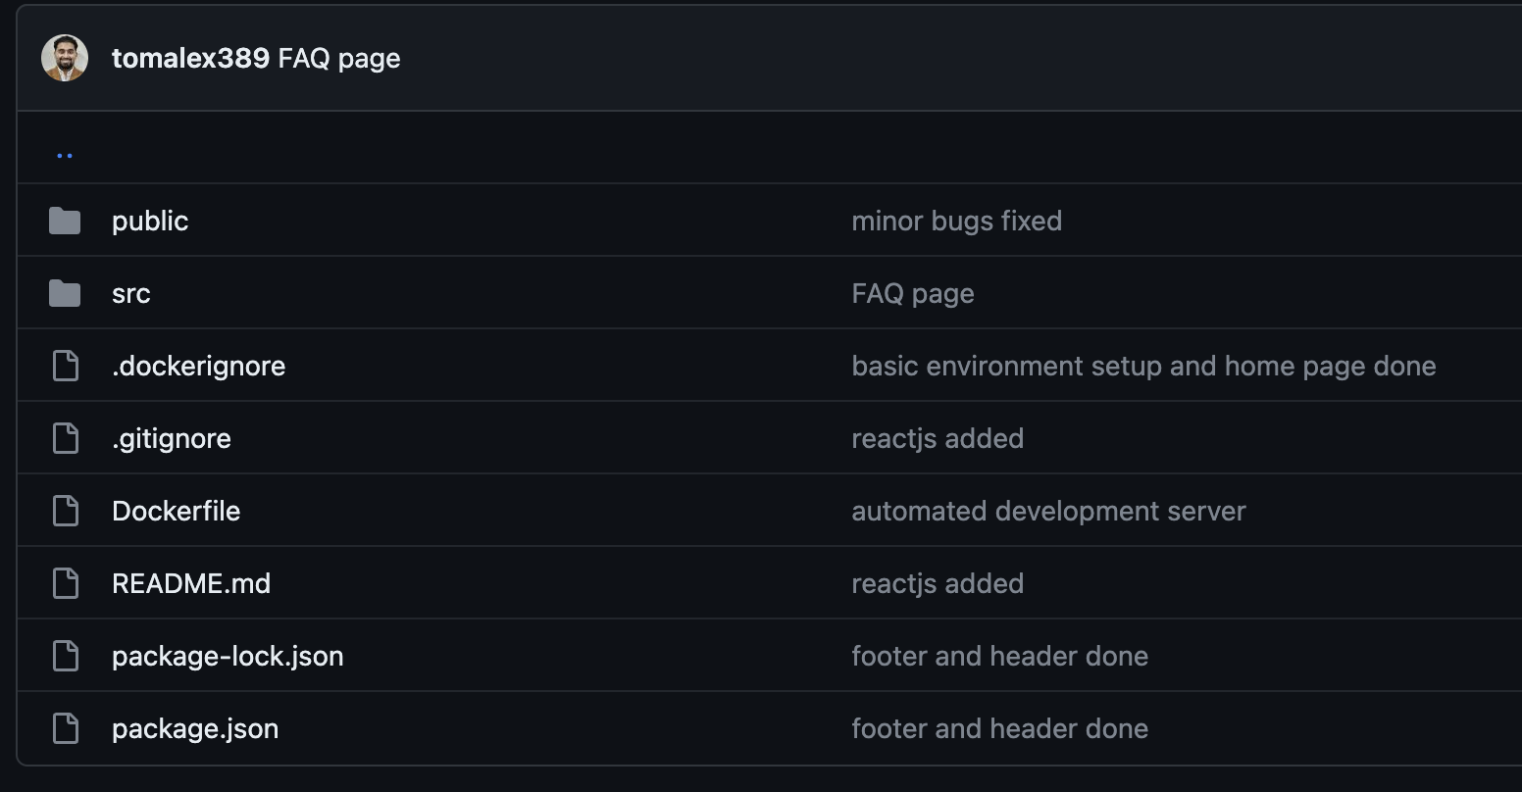
11. GitHub Repository – Tom Alex
Git Hub Link : https://github.com/swayambhu/parkEz
Backend and Frontend

Slide 13
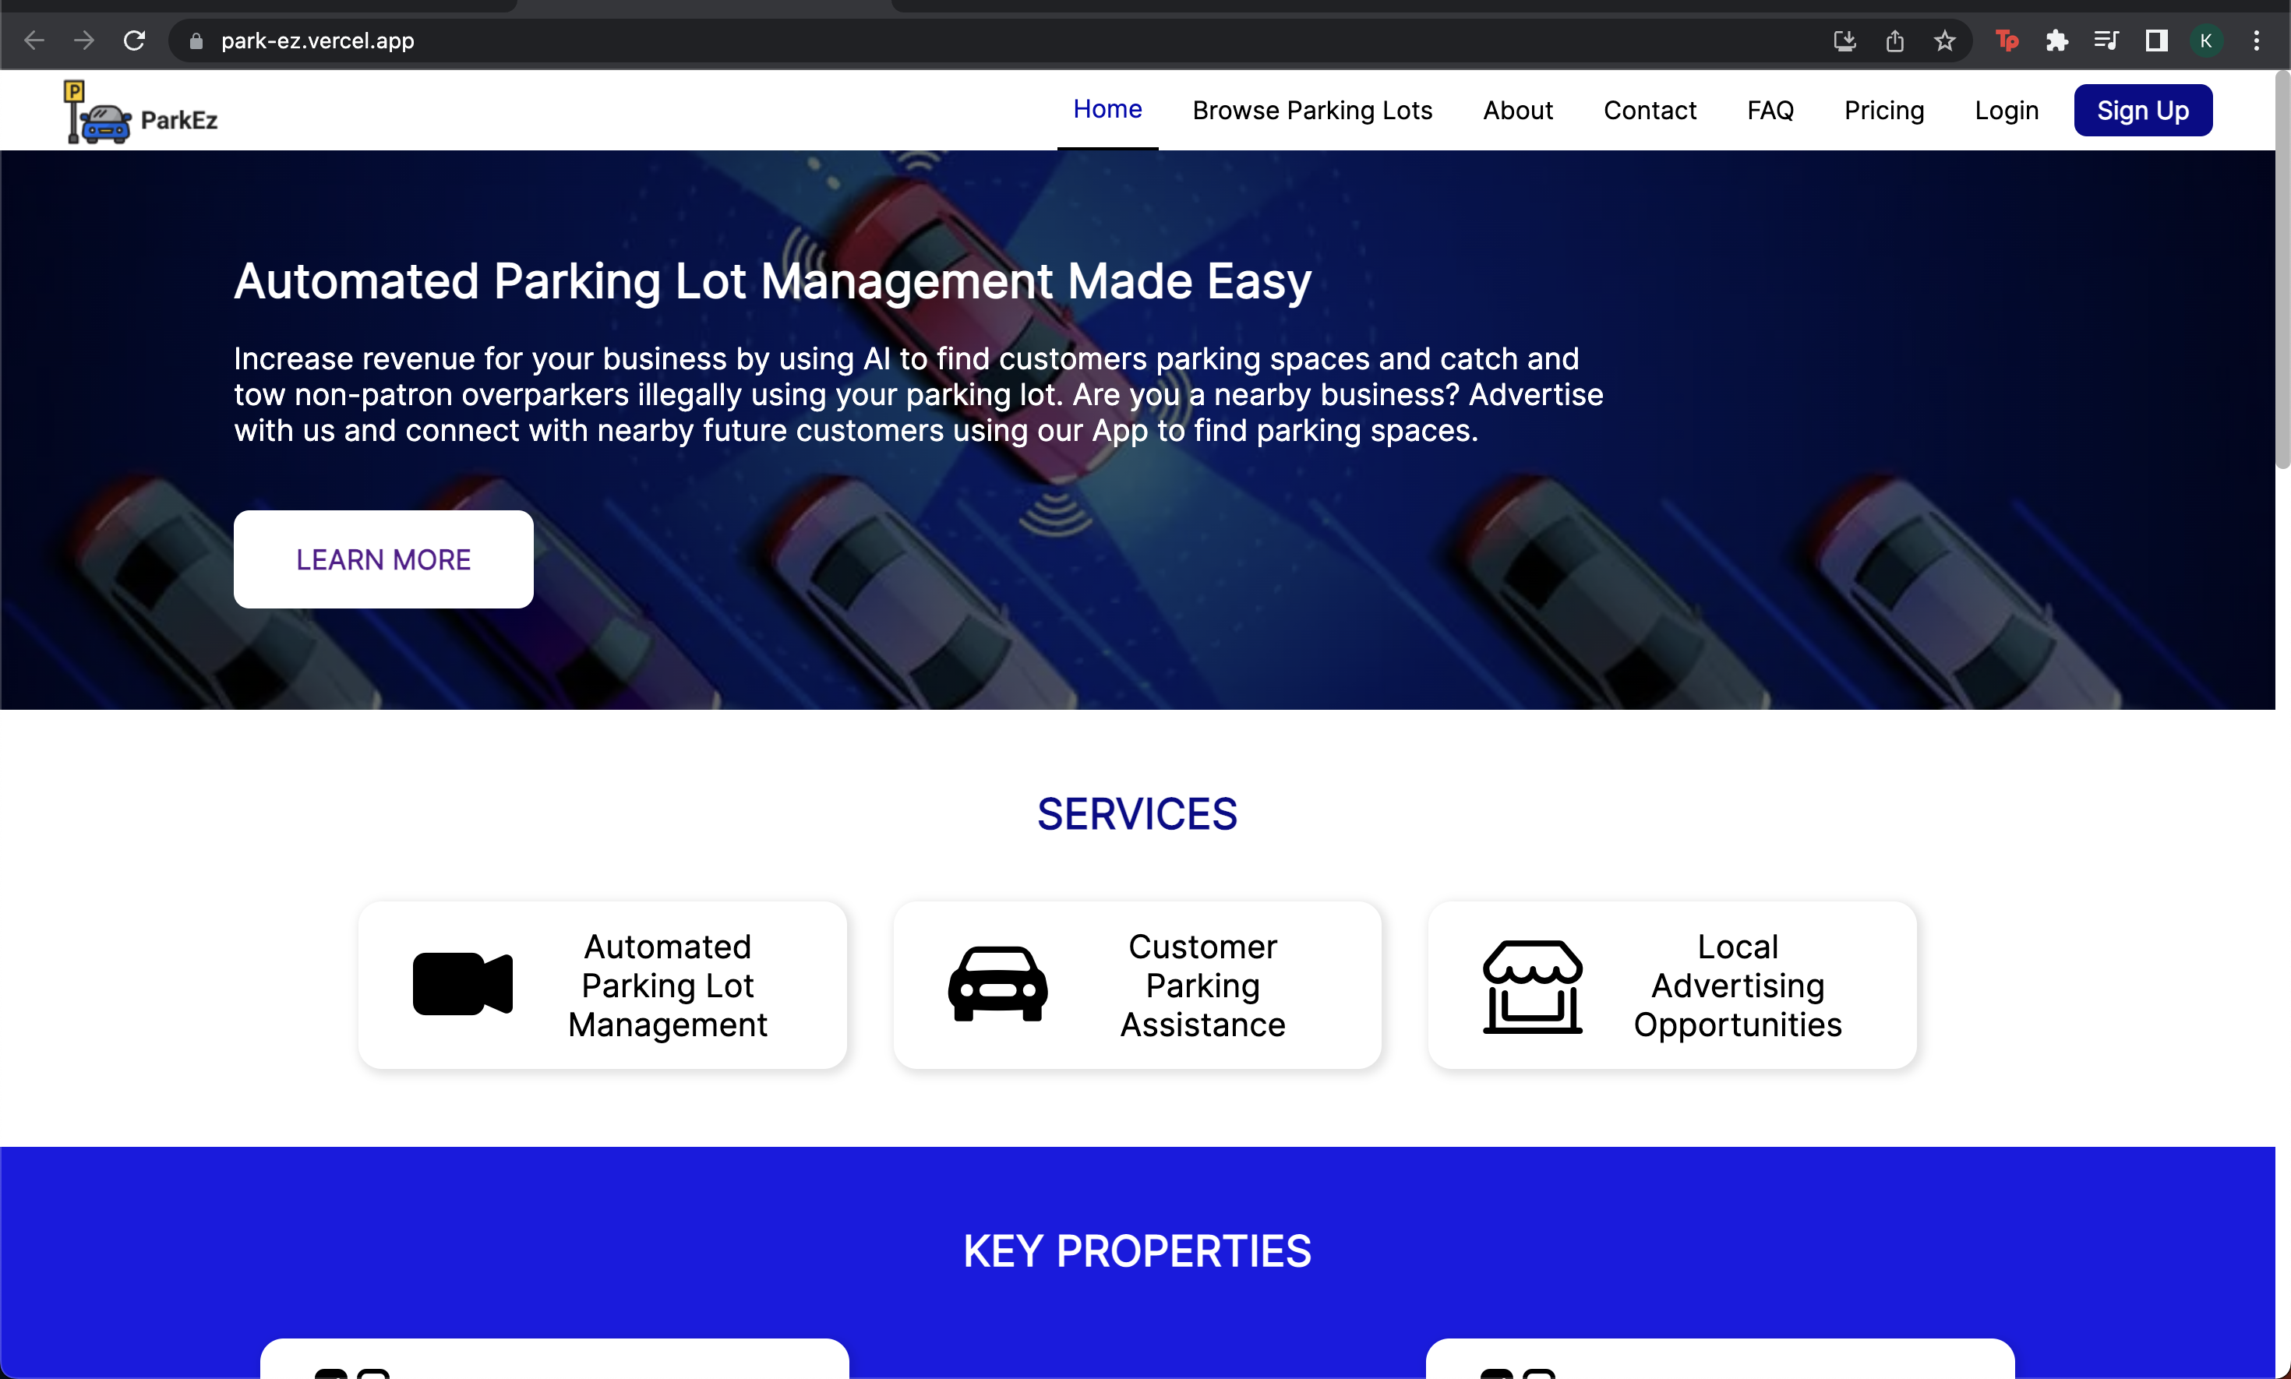
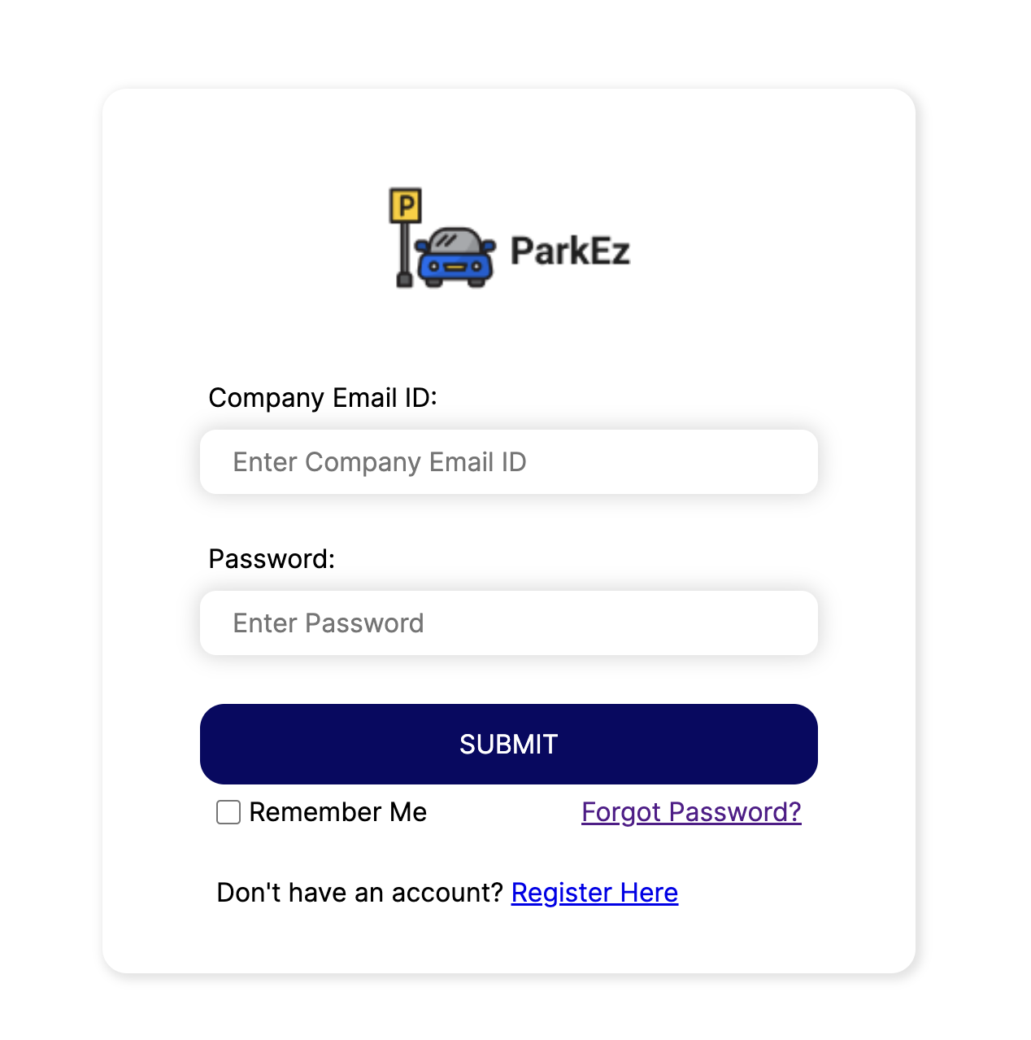
12. Live Demo – Swayambhu Dhuri
Live Demo : https://park-ez.vercel.app/

Slide 14
Thank You

